Slide 1


Stripe Business Case
AI Data Architecture Design and Deployment

Slide 2
Context
Stripe: growing online payment processing platform
Increasing complexity of data management across platforms
Necessity to refactor the data infrastructure and pipelines
Integration of the infrastructure with data sources and consumers

Slide 3
Context
Tasks
Stripe: growing online payment processing platform
OLTP data model
OLAP data model
Increasing complexity of data management across platforms
NoSQL data model
Data integration architecture
Necessity to refactor the data infrastructure and pipelines
Security and compliance plan
Machine learning integration
Integration of the infrastructure with data sources and consumers
Example SQL and NoSQL queries

Slide 4
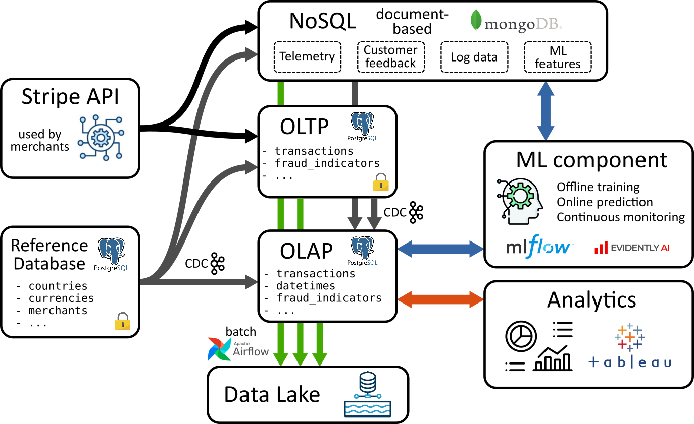
Pipeline architecture

Slide 5
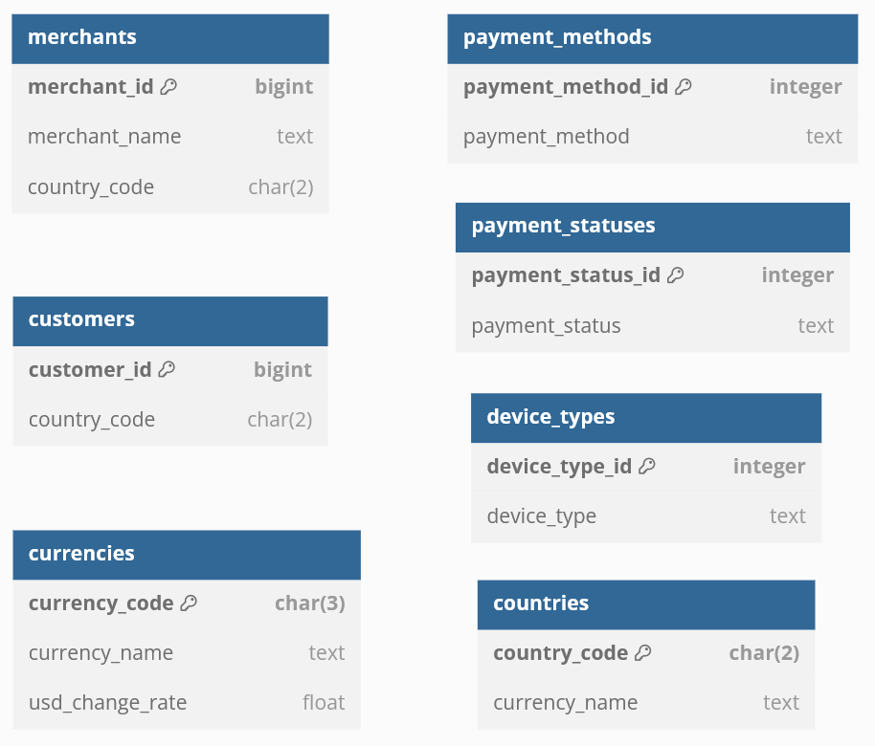
Reference Database
Slowly changing/static data
e.g., countries reference, merchants info, change rates
Source of truth for OLTP/OLAP/NoSQL
Updates propagated through Change Data Captures (CDC)
Holds sensitive information
- field-level encryption
- encrypted transfer (TLS 1.3)
- strict access control and logging

Slide 6
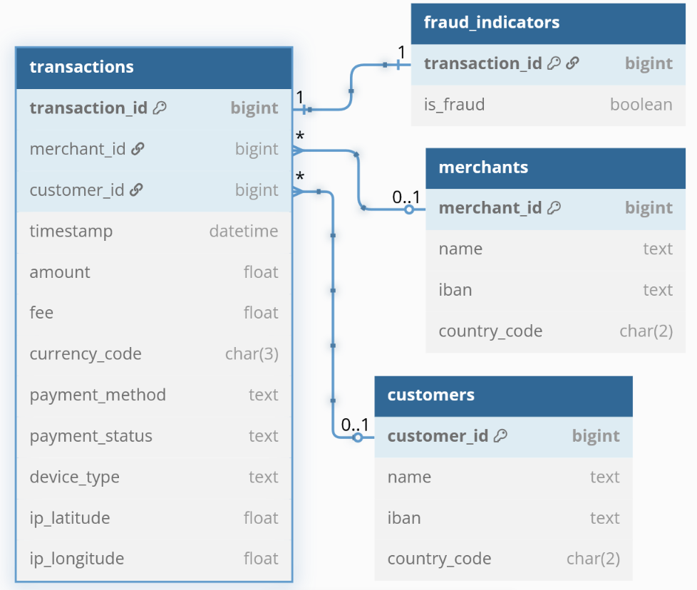
Online Transaction Processing (OLTP)
Core transactional operations: payments processed through Stripe API
High integrity, performance and reliabilty
Normalized schema (3NF)
Low redundancy, high consistency
ACID properties
Atomicity, Consistency, Isolation, Durability
Propagate downstream through Change Data Captures (CDC)
Holds sensitive information
- field-level encryption
- encrypted transfer (TLS 1.3)
- strict access control and logging

Slide 7
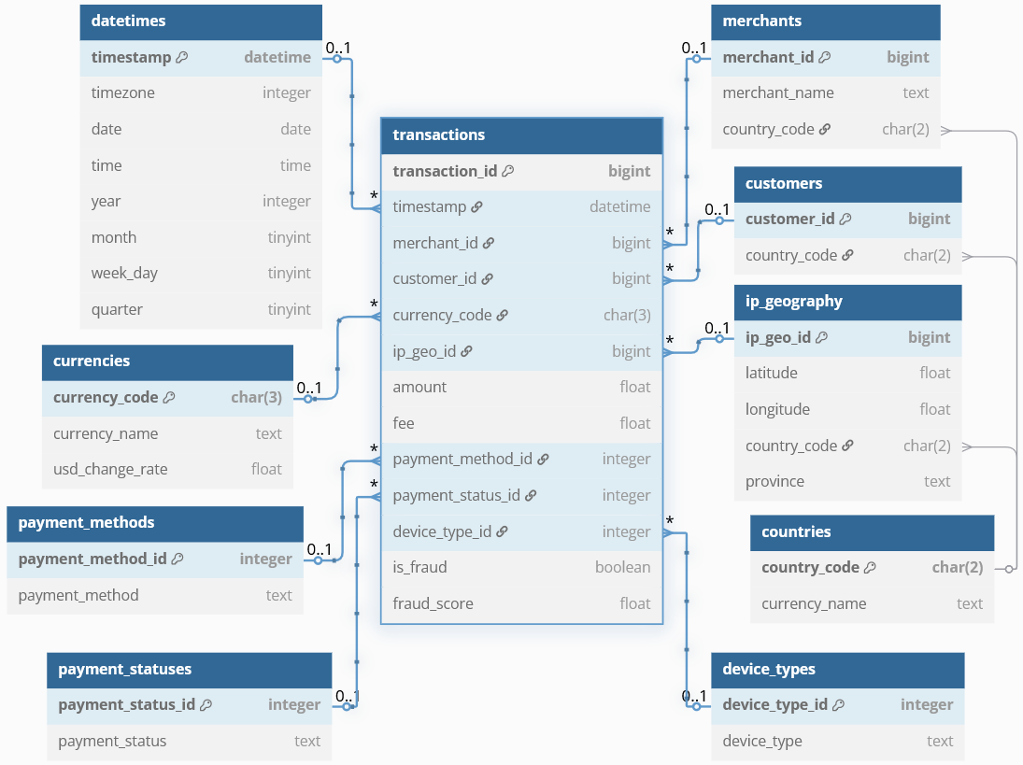
Online Analytical Processing (OLAP)
Analytical queries and BI
High availability, fast queries
Star schema architecture
transactions fact table
Pre-aggregations, views
for performance optimization
Connected to analytics and machine learning components
Less-sensitive information
- Anonymized data
- Access control and logging

Slide 8
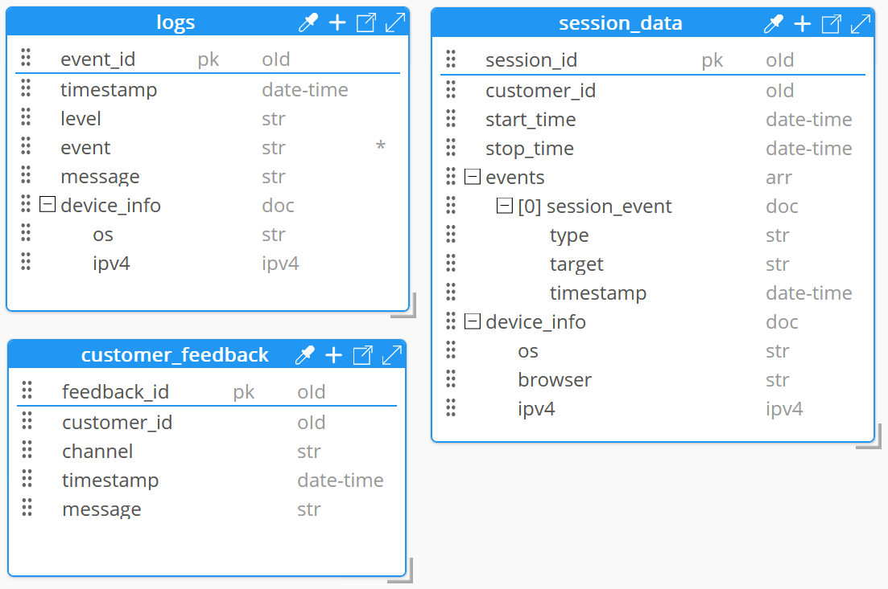
NoSQL Database
Document-based for semi-structure and unstructured data
Telemetry, customer feedback, logs, ML features
Embedded documents
for tightly coupled data (e.g. device info)
Document referencing
to link large documents
(e.g. session data and customer feedback)
No sensitive information stored
- Anonymized data
- Access control and logging

Slide 9
Compliance
Compliance
Compliance
Compliance
Compliance with international regulations (PCI-DSS, GDPR, etc)
Confidential information in Reference and OLTP databases
Encryption, strict access policy and logging
No sensitive data in OLAP and NoSQL databases
Anonymous or tokenized data
Creation of encrypted backups

Slide 10
Compliance
Compliance
Compliance
Compliance
ML Integration
Features extraction from
OLAP and NoSQL databases
Compliance with international regulations (PCI-DSS, GDPR, etc)
Batch orchestration with Apache Airflow
Confidential information in Reference and OLTP databases
Model management with MLflow
Traceability, version control
Encryption, strict access policy and logging
Online inference through APIs
No sensitive data in OLAP and NoSQL databases
e.g. for fraud scoring, queried by OLAP
Deployment within Kubernetes
Anonymous or tokenized data
High-availability infrastructure
Creation of encrypted backups
Monitoring with Evidently
Data drift, performance degradation

Slide 11

Thanks!

